Slide 1
PERFORMATIVE ANALYSIS OF OPTIMIZERS ON FINE-TUNED LUNG DISEASE
CLASSIFICATION
Ray Hu, Cong Wei, Jiandong Guan, Suhas Raghavendra

Slide 2
Project Motivation
Machine learning models are changing computing by solving tasks that were once thought impossible. To do this, they need to be trained on specific data to find the best settings for solving problems. This training takes a lot of computing power, but using a good optimizer can help the model find the right settings more efficiently. While many optimizers work well, we want to test different ones to see if some perform better.
This could be especially useful in fields like medicine. For example, in lung research, doctors need very accurate models to diagnose problems. A general-purpose model might not be good enough. Our work could help researchers find ways to reduce errors and improve results in lung disease studies.
Notes:
Jayden

Slide 3
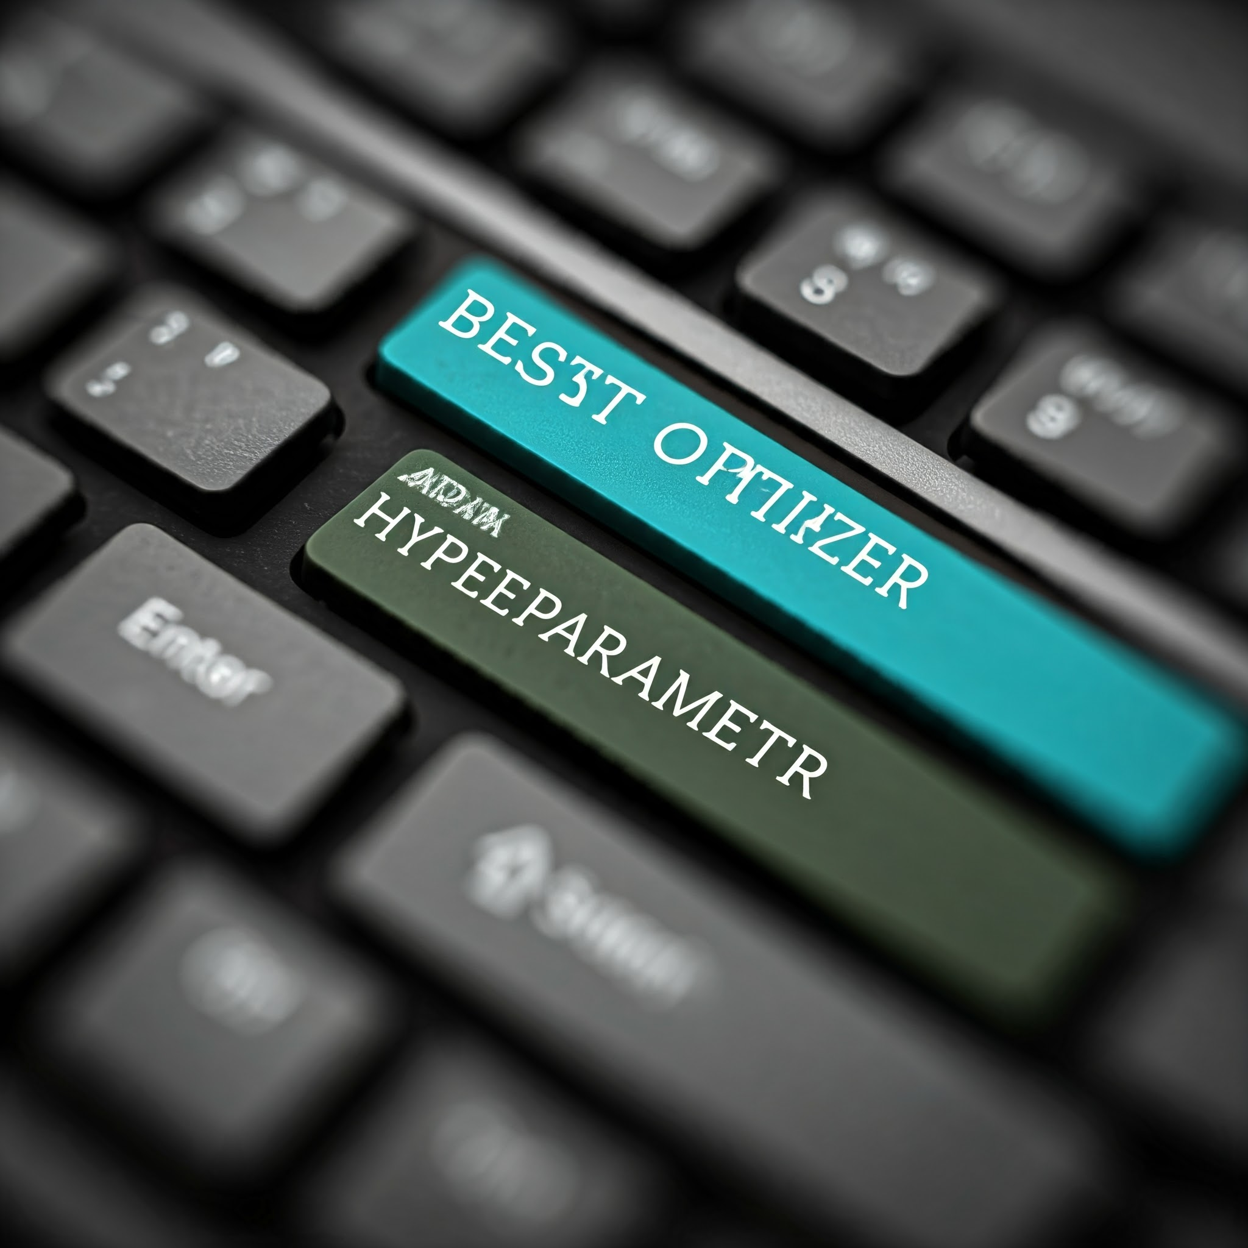
Project Description
Different optimizer algorithms are tested in image classification models for lung disease. Various hyperparameters are applied to identify cases where one optimizer performs better than the standard model. Performance is measured using the weighted average F1 score on the validation set and the final score on the test set.
Notes:
Jayden

Slide 4
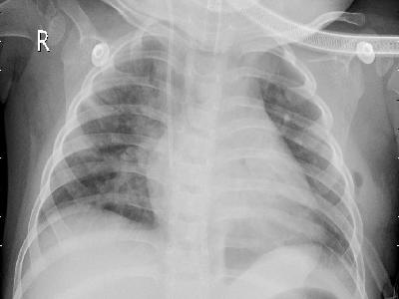
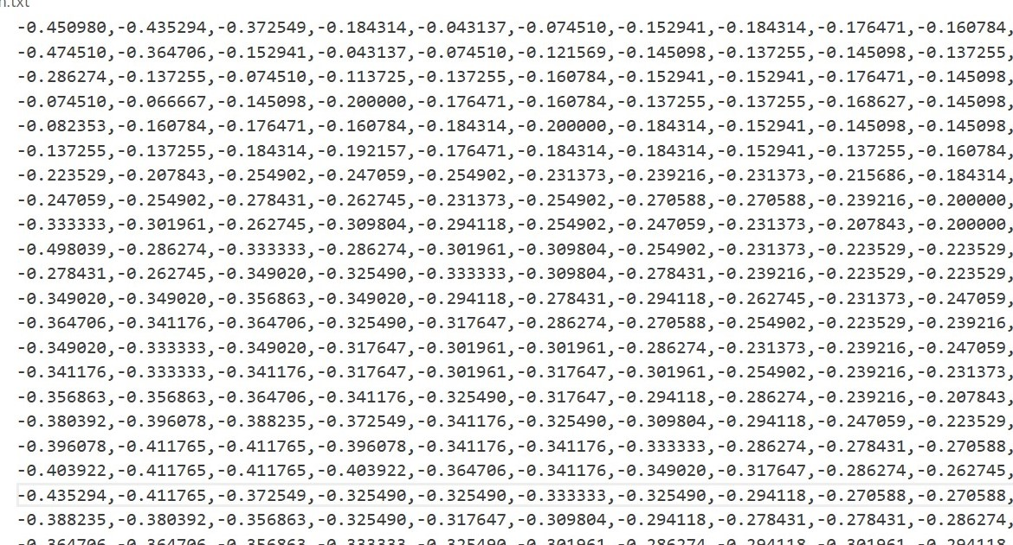
Dataset Description
The dataset, sourced from Kaggle, contains chest X-ray images and is compiled from various datasets. The dataset includes four types of lung diseases such as Bacterial Pneumonia, covid-19, Tuberculosis, Viral Pneumonia, as well as a folder for normal lungs. To expand the dataset, it was augmented by a factor of 6, resulting in a total of 10,000 images.
Data Processing
To prepare the dataset for model training, image transformations are applied, including resizing, converting tensors to matrices, and normalizing the matrices.
Notes:
Jayden

Slide 5
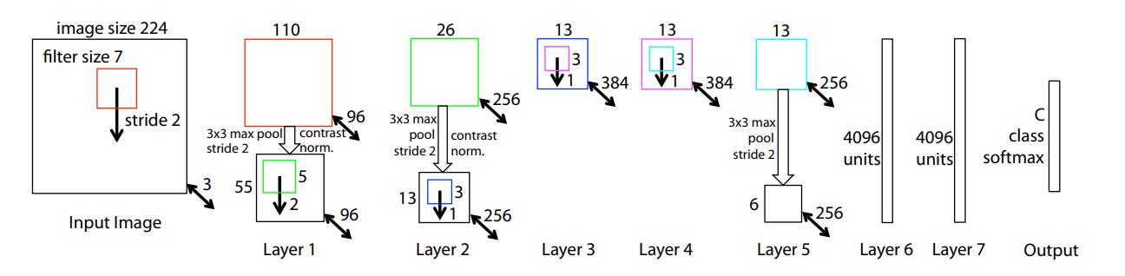
Proposed Models: ZF-Net
CNN Based Model, developed by Matthew D. Zeiler and Rob Fergus
Improvement over widely-known Alex-Net
CNNs are “traditional” models used for image classification
Zeiler, M. D., & Fergus, R. (2013, November 28). Visualizing and understanding Convolutional Networks. arXiv.org. https://arxiv.org/abs/1311.2901
Notes:
Ray

Slide 6
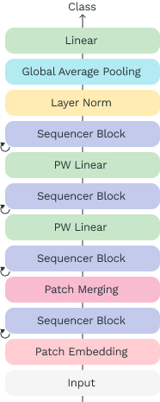
Proposed Model: Sequencer-2d
LSTM based model, developed by Yuki Tatsunami and Masato Taki
LSTMs, while less known, can still be used for image classification
Authors’ “Sequencer” blocks are made up of bi-directional LSTMs
Challenges traditional transformer based models by replacing attention blocks with aforementioned Sequencer blocks.
Tatsunami, Y., & Taki, M. (2023, January 12). Sequencer: Deep LSTM for image classification. arXiv.org. https://arxiv.org/abs/2205.01972
Notes:
Ray

Slide 7
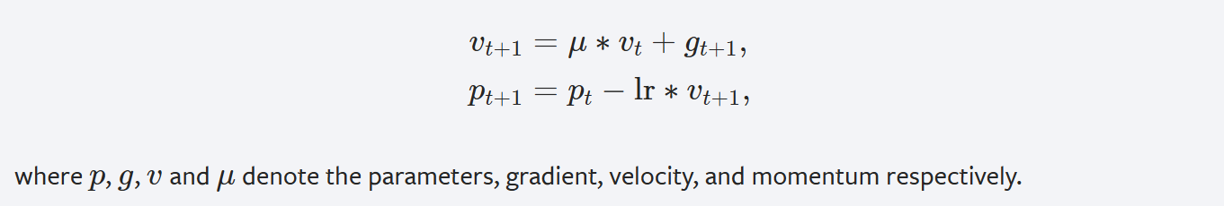
Optimizers: SGD (stochastic gradient descent)
Only requires one sample gradient of the training data for every step, relatively efficient way to compute descent direction
Prediction: We believe SGD performs best in scenarios where the batch sizes and learning rate are bigger as it seems to excel in quick computation.
In Pytorch, we are using SGD with Nesterov’s momentum and momentum value of 0.9 to help it converge faster. optim.SGD(model.parameters(), lr=LR, momentum=0.9, nesterov=True)
Notes:
Ray

Slide 8
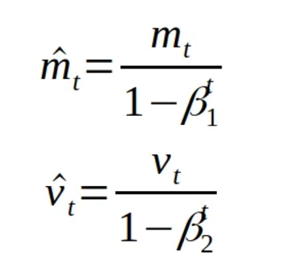
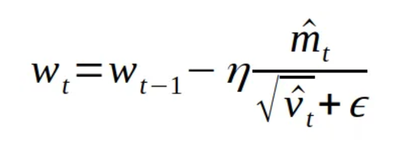
Optimizers: AdamW (Adaptive Moment Estimation)
One of the most popular optimizers for deep learning algorithms, uses first order gradients and a moving average to converge faster than most other deep learning optimizers
Prediction: Since it is the current state-of-the-art optimizer, we believe it performs best in the “default” or baseline hyperparameter cases and and smaller training cycles.
In PyTorch, we are using AdamW with the default beta values of (0.9, 0.999). optim.AdamW(model.parameters(), lr=LR, betas=(0.9, 0.999))
Notes:
Ray

Slide 9

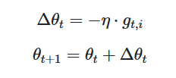

Optimizers: Adadelta (Adaptive Learning Rate Method)
Adds a moving window of gradients to determine best learning rate for each feature, represents a middle ground between static learning rate optimizers and advanced dynamic optimizers.
Prediction: We believe that Adadelta could work best in cases where the hyperparameters differ moderately from the baseline hyperparameters.
In PyTorch, we are using Adadelta with the default parameters. optim.Adadelta(model.parameters(), lr=LR)
Notes:
Ray

Slide 10
Hyperparameter Variations
50 Epochs
100 Epochs
ZF-Net | Batch size | Learning Rate | Dropout
Baseline | 32 | 1e-4 | 0.5
HP 1 | 64 | 1e-2 | 0.5
HP 2 | 16 | 1e-4 | 0.25
Sequencer-2d | Batch size | Learning Rate
Baseline | 32 | 1e-4
HP 1 | 64 | 1e-2
HP 2 | 16 | 1e-4
Notes:
Ray

Slide 11
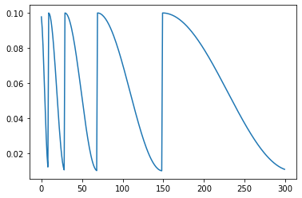
Scheduler Variation
Batch size | Learning rate
32 | 1e-2
Scheduler: Function to adjust the learning rate of an optimizer for every epoch.
Advantages: If used correctly, it can lead to faster convergence or an escape of a local minima.
Disadvantage: Depends on the function to minimize. More variables to consider, may overshoot or undershoot a minima.
In Pytorch, we are using CosineAnnealingWarmRestarts as our scheduler. lr_scheduler.CosineAnnealingWarmRestarts(optimizer, T_0=10, T_mult=2)
Notes:
Ray

Slide 12
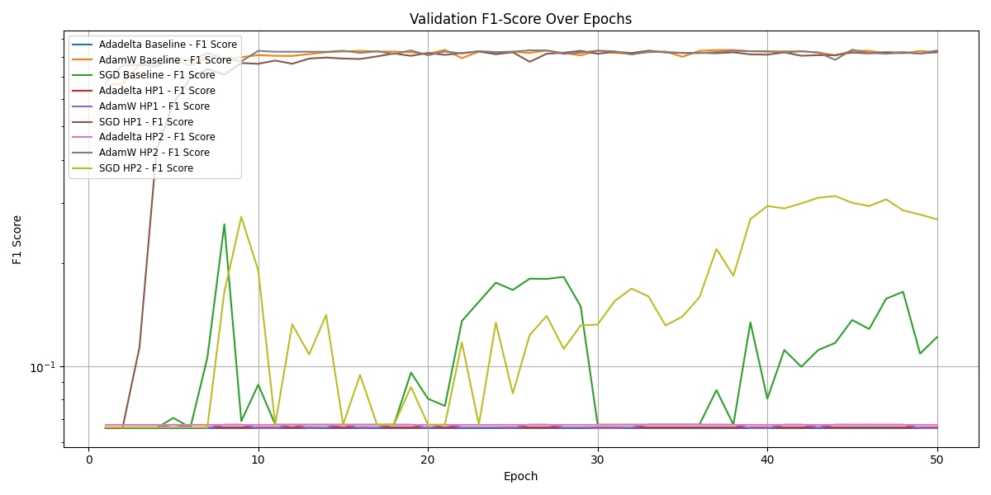
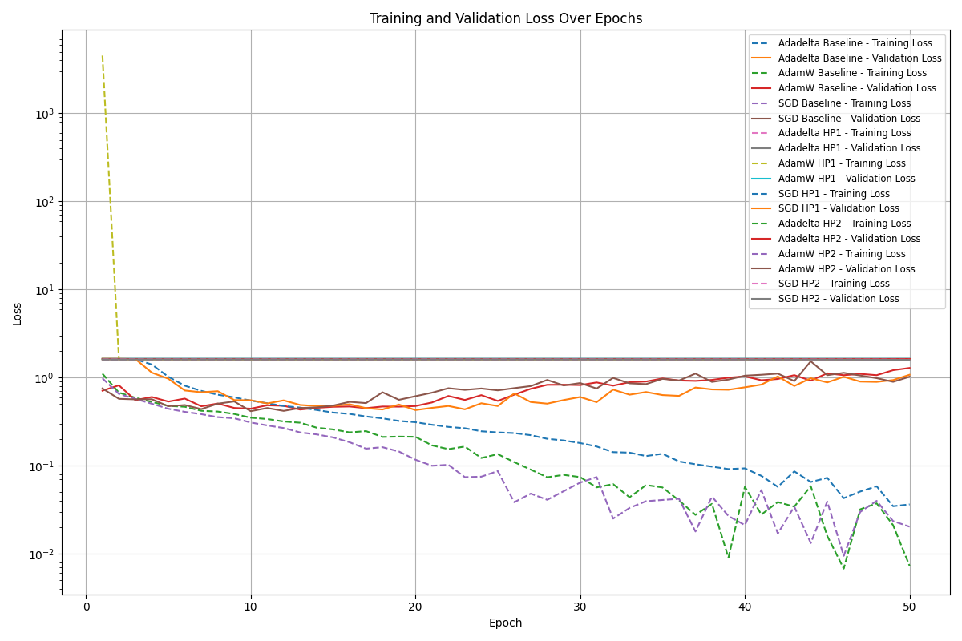
Data Visualization CNN
AdamW and SGD demonstrate strong, adaptable performance, while Adadelta underperforms across metrics
Notes:
David

Slide 13
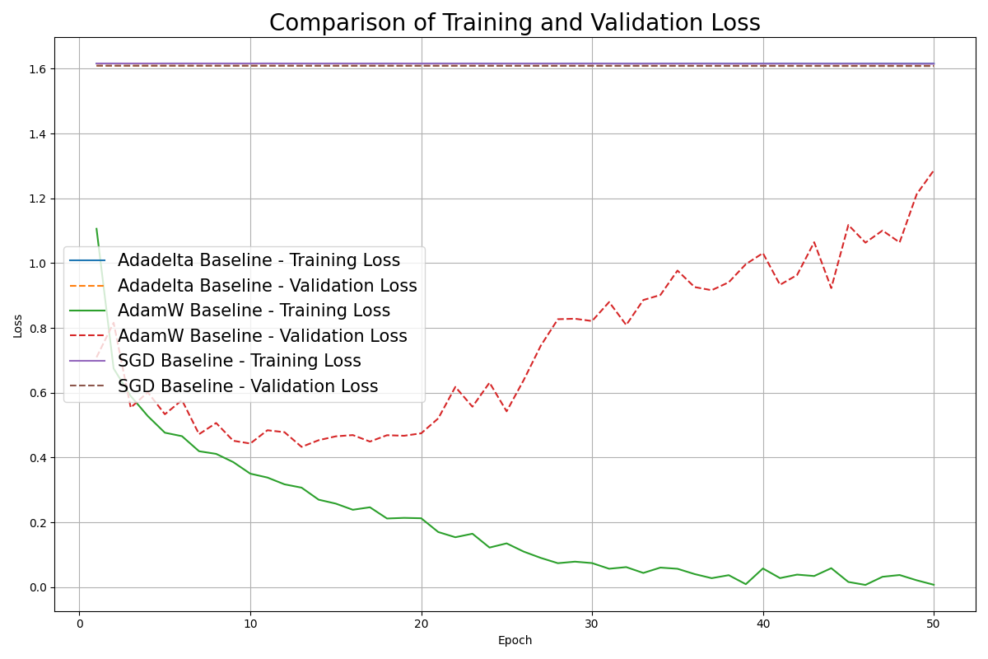
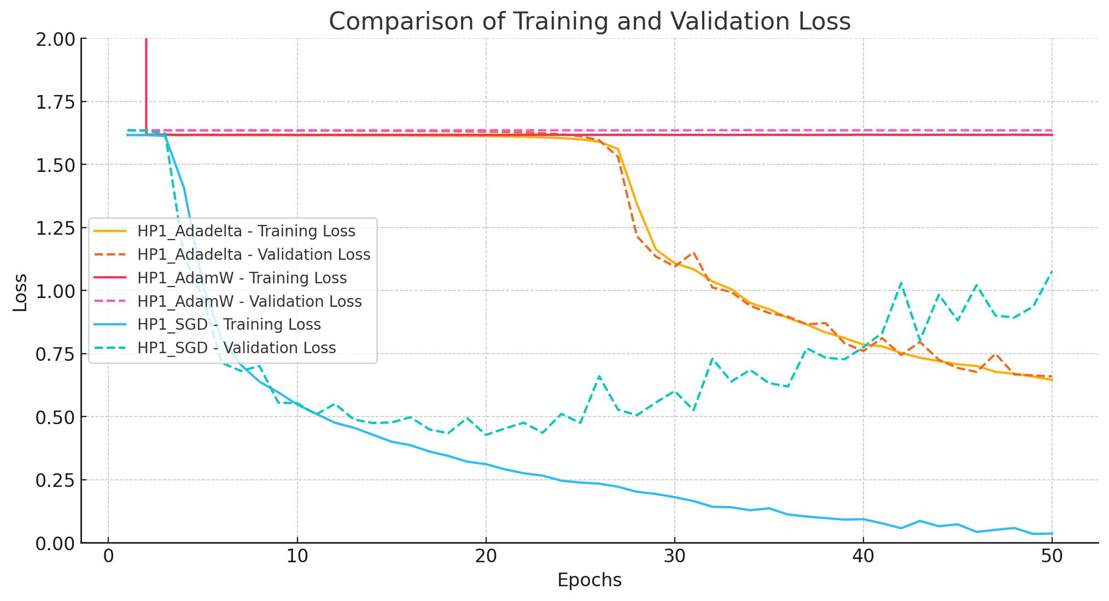
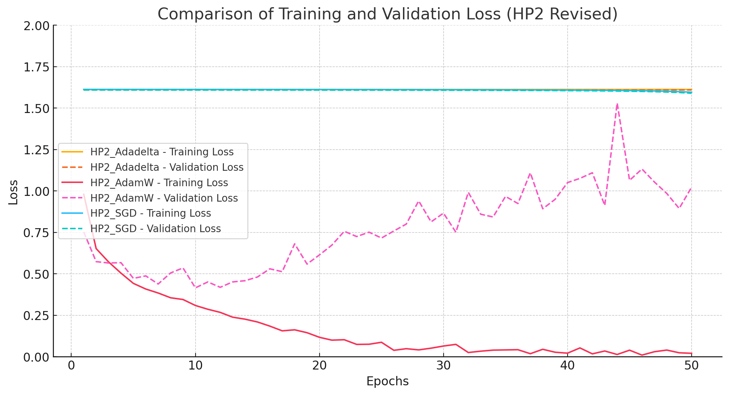
CNN Hyperparameters comparison
Left is baseline, middle is HP1, right is hp2. While SGD provides the most consistent and efficient training behavior, AdamW requires careful tuning to mitigate overfitting. Adadelta may be unsuitable for this task due to its limited learning capability

Slide 14
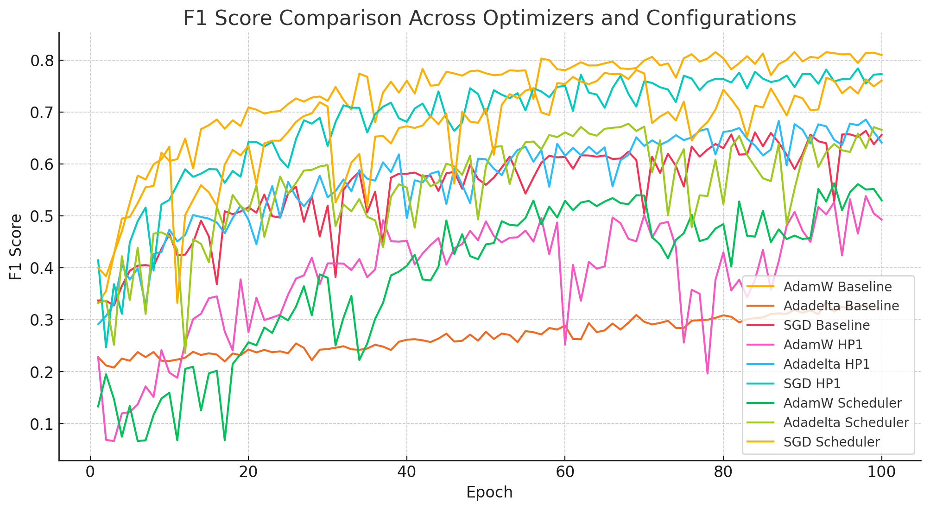
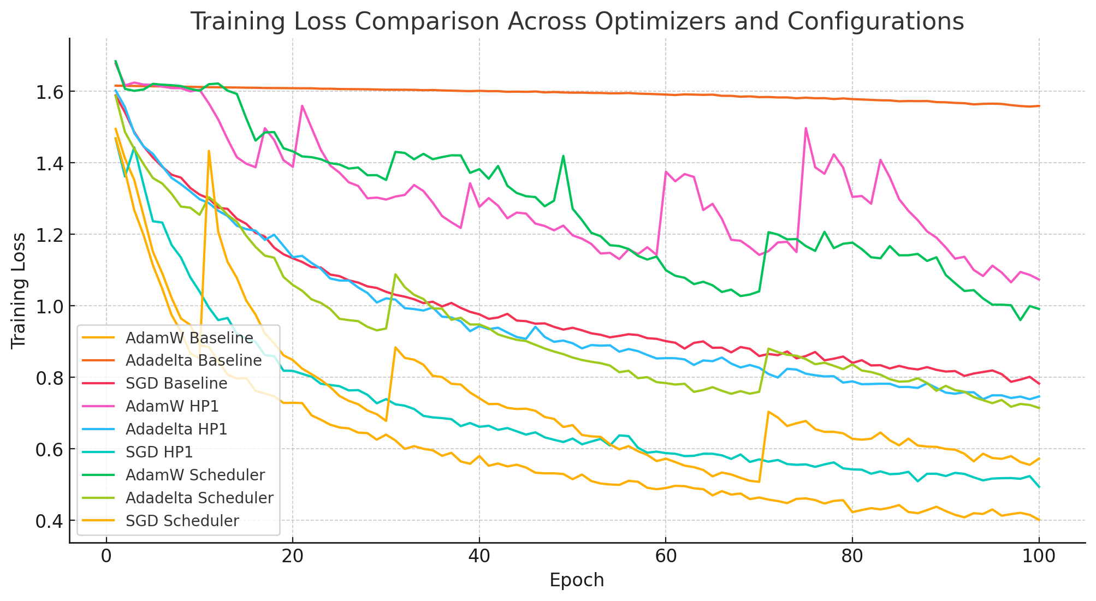
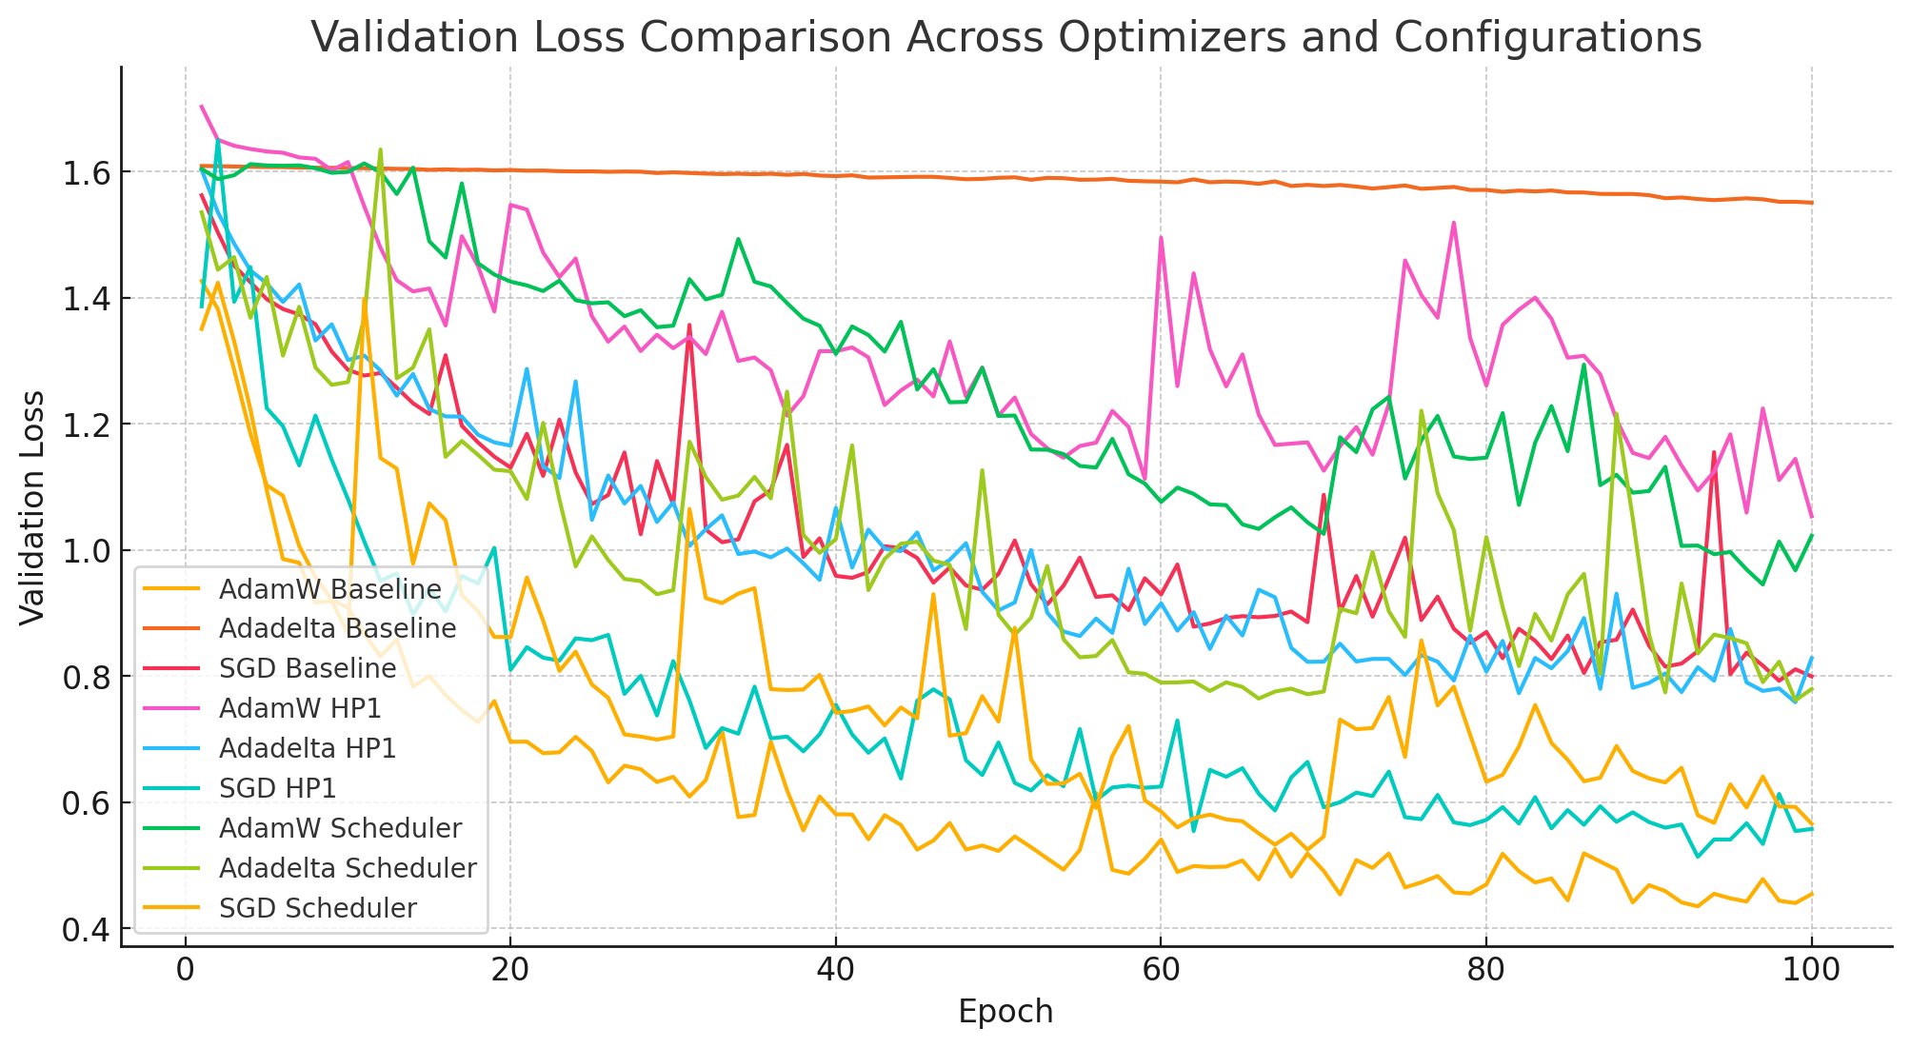
Data Visualization LSTM
AdamW and SGD demonstrate strong, adaptable performance, while Adadelta underperforms across metrics
Notes:
David

Slide 15
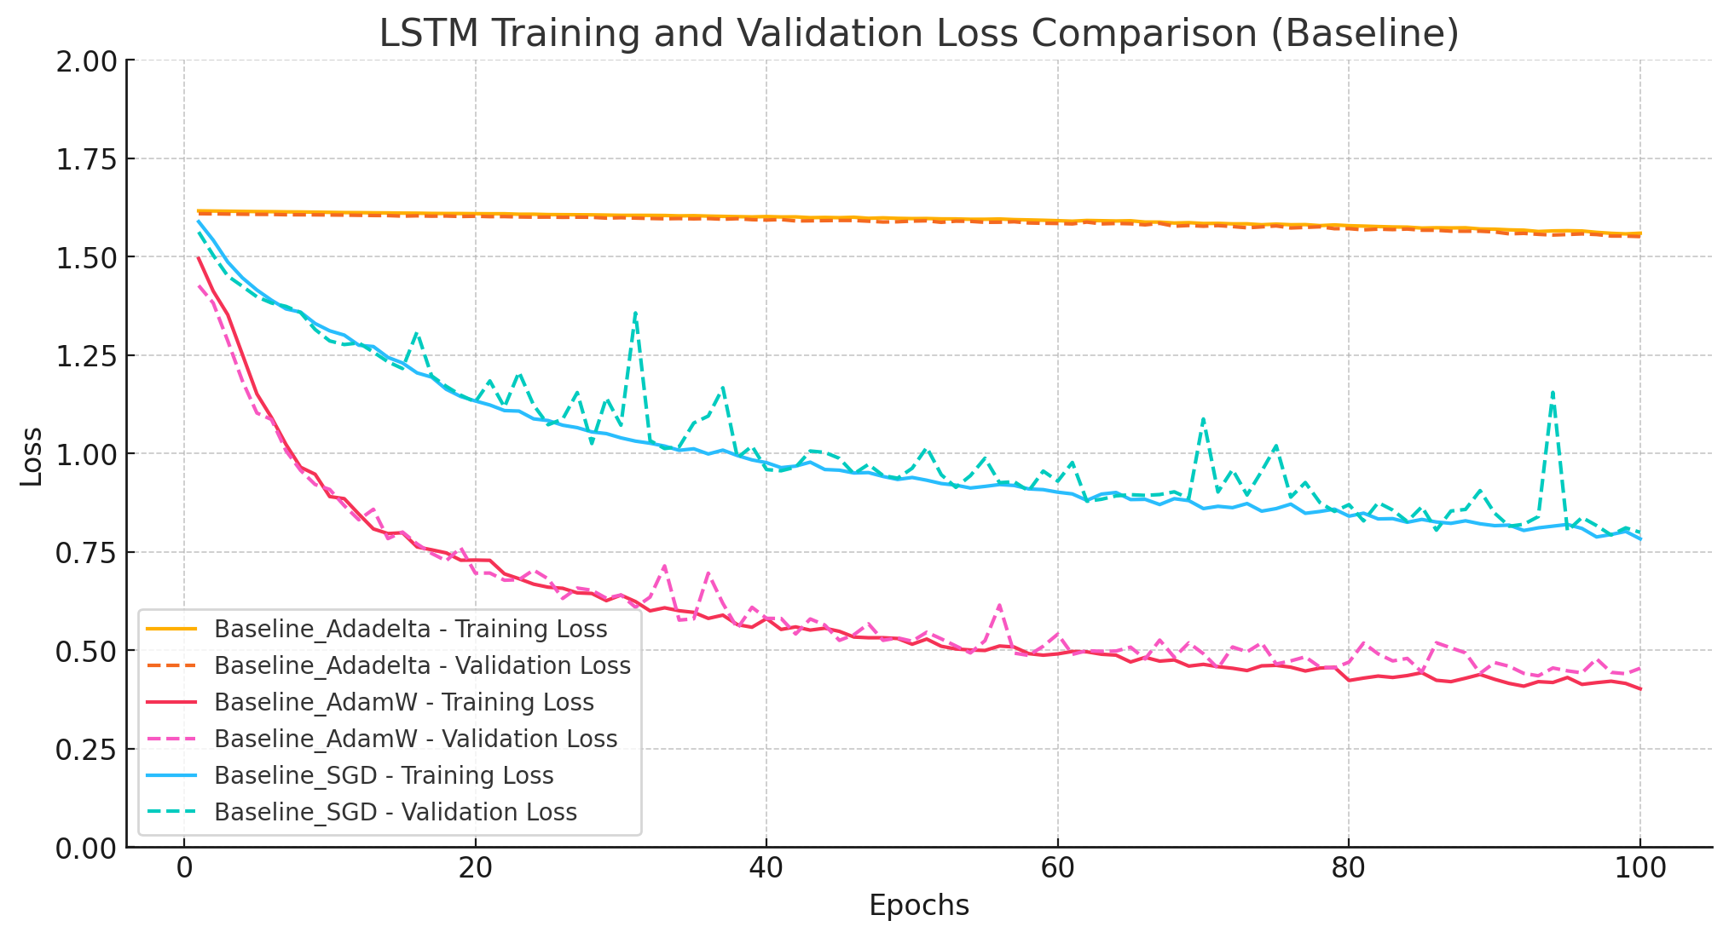
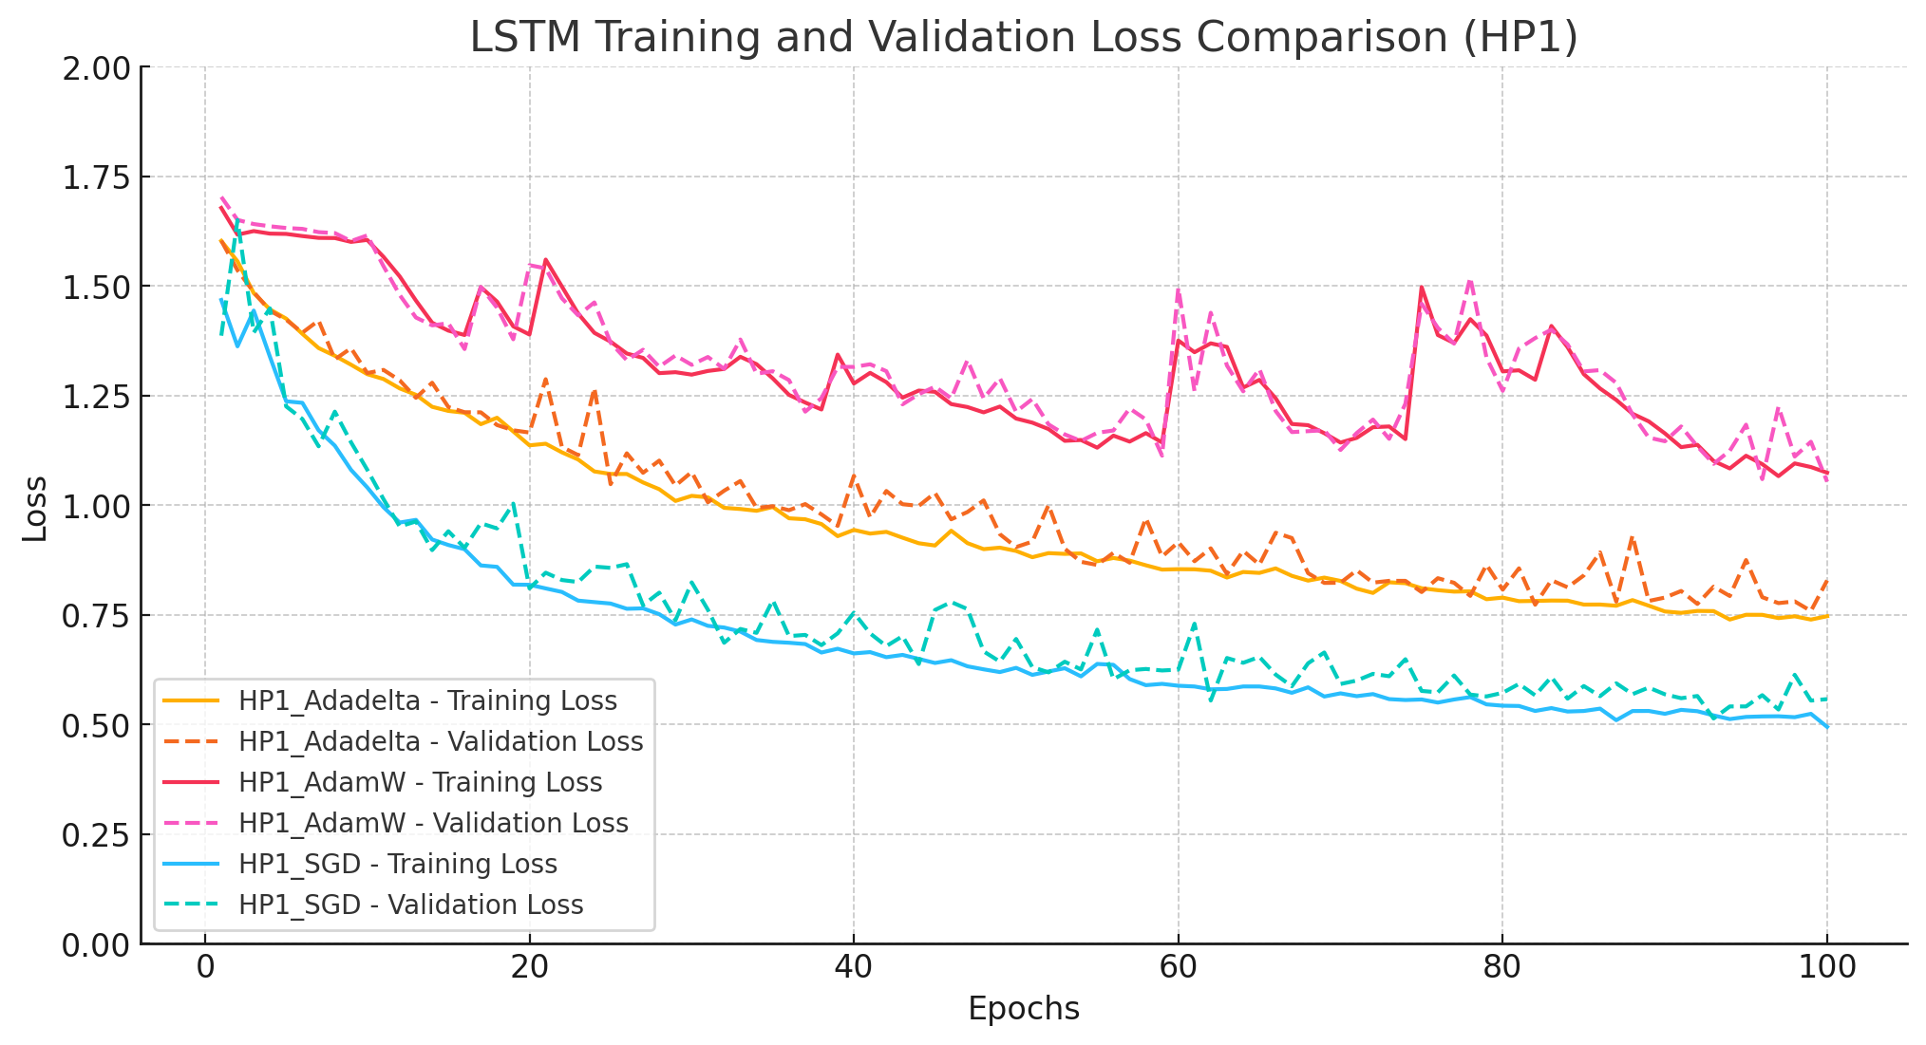
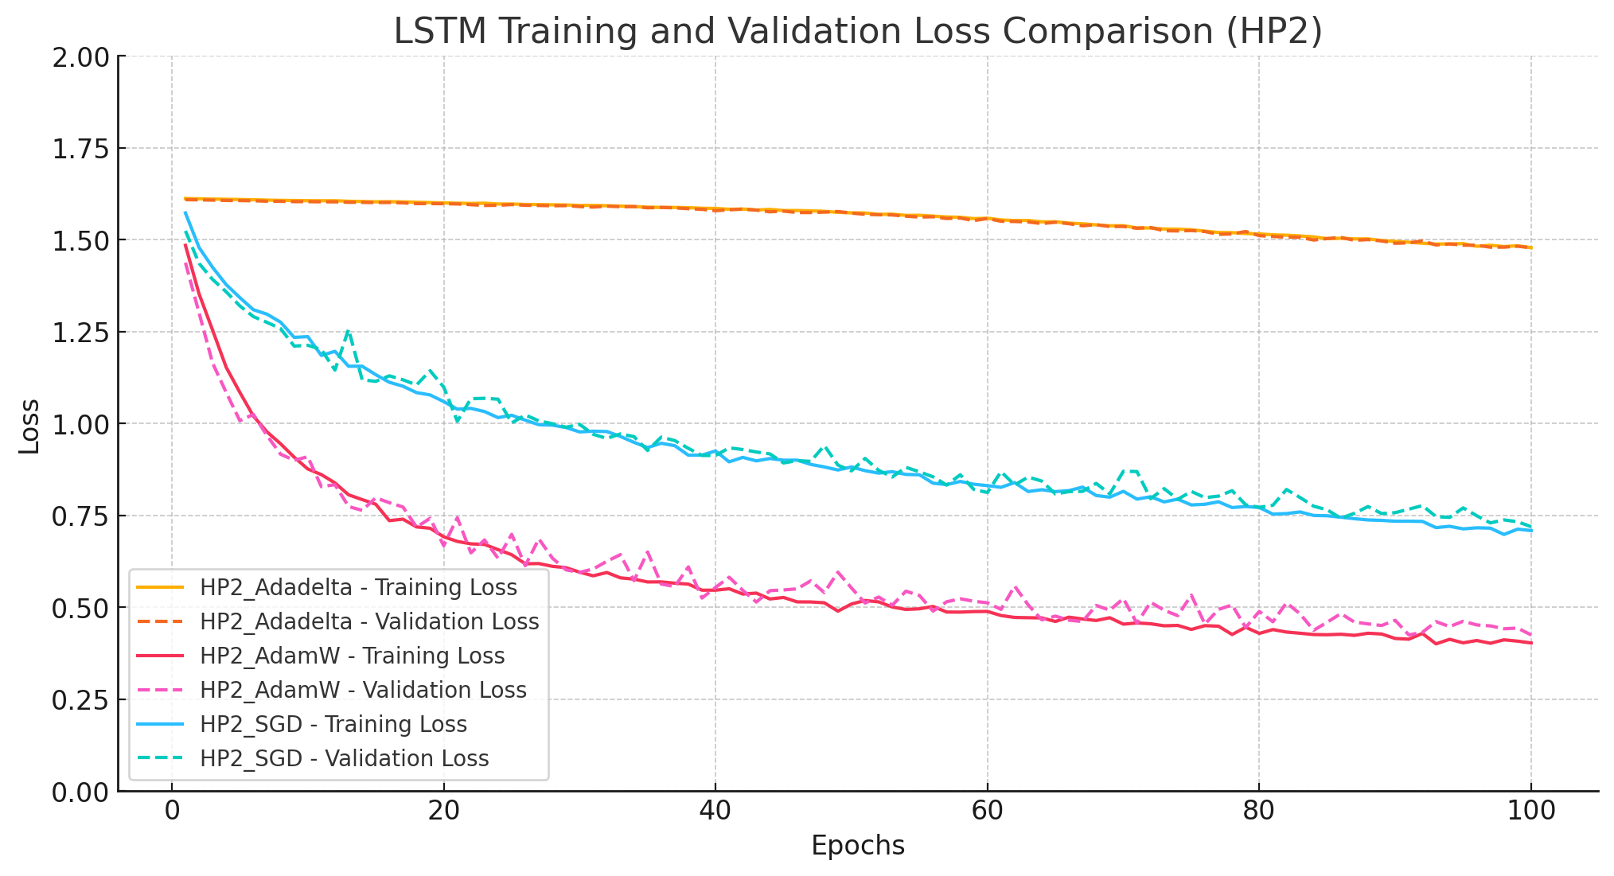
LSTM Hyperparameters comparison
Across all configurations, SGD emerges as the most stable and effective optimizer, while AdamW, with proper tuning, can outperform in terms of loss reduction. Adadelta's performance suggests it's not well-suited for this task.

Slide 16
Future Work
Using the same optimizer and the same set of hyperparameters that were applied in the previous model, we can train the ResNet model to maintain consistency in the comparison.
ResNet introduces the concept of residual learning, where the model learns the residual between the input and the output, rather than learning the output directly.
Exploring more optimizers and hyperparameters to see if any combination improves the model's performance. This includes testing various learning rates, batch sizes, and optimization methods to find the best setup for faster training and higher accuracy."
Notes:
Suhas

Slide 17
Conclusion
Our study highlights the transformative impact of machine learning optimizers in fine-tuning image classification models, specifically for lung disease diagnosis. By experimenting with optimizers such as SGD, AdamW, and Adadelta across varying hyperparameters, we identified scenarios where certain optimizers excel in efficiency and accuracy.
We demonstrated the potential of these techniques using models like ZF-Net, Sequencer-2d, and ResNet, trained on an augmented dataset of 10,000 chest X-ray images.
Key findings show that AdamW performs well in baseline setups, SGD excels with larger learning rates, and Adadelta adapts effectively to moderate hyperparameter shifts. This work underscores the importance of optimizer selection and hyperparameter tuning in achieving robust, accurate diagnostic tools in the medical field
Notes:
Suhas

